Slide 1

K-Means
Dr. Linrui Zhang
University of Central Missouri

Slide 2
Machine Learning
Machine Learning
Supervised Learning f(x)
Reinforcement Learning
Unsupervised Learning
Clustering
Parametric
Linear Regression
Logistic Regression
Decision Tree
Perceptron
Neural Network
SVM
…
Non Parametric
Instance-based Learning
KNN

Slide 3
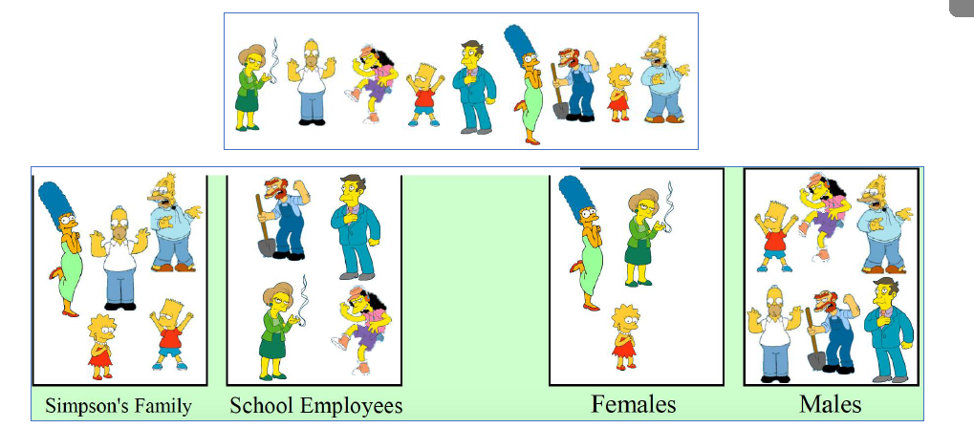
Clustering
Clustering
Input: some data
Goal: infer group information
Clustering systems:
Unsupervised learning
Require data, but no labels
Detect patterns
E.g. Customer shopping patterns
Useful when don’t know what
you’re looking for

Slide 4
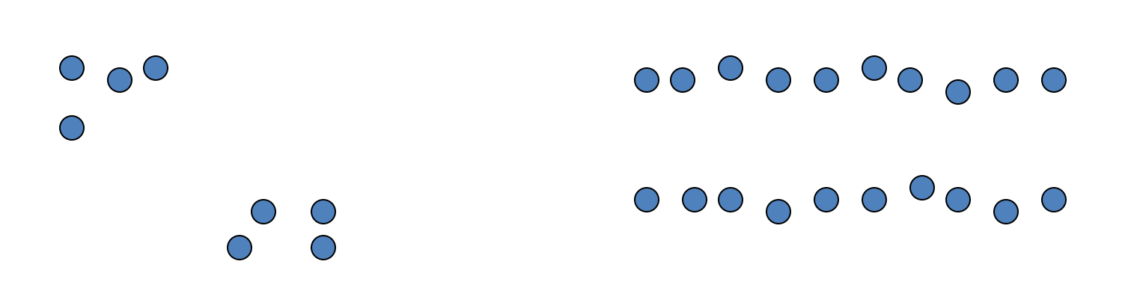
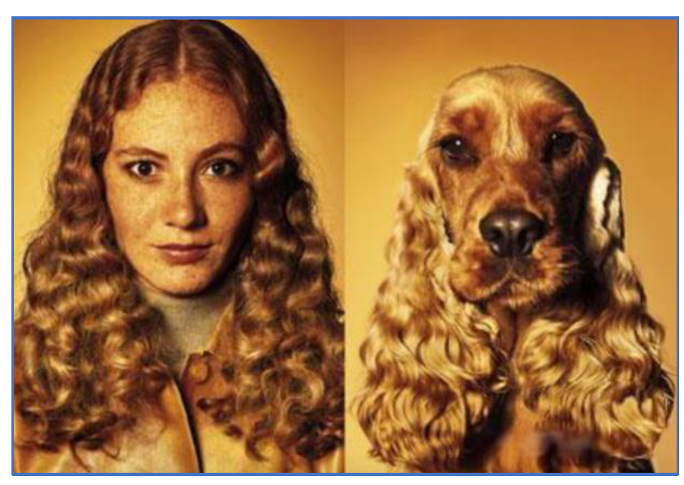
Clustering
Basic idea: group together similar instances
Example: 2D point patterns
What could “similar” mean?
One option: small distance
Clustering is subjective

Slide 5
K-Means
An iterative clustering algorithm
Pick K random points as cluster centers (means)
Alternate:
Assign data instances to closest cluster center
Change the cluster center to the average of its assigned points
Stop when no points’ assignments change

Slide 6
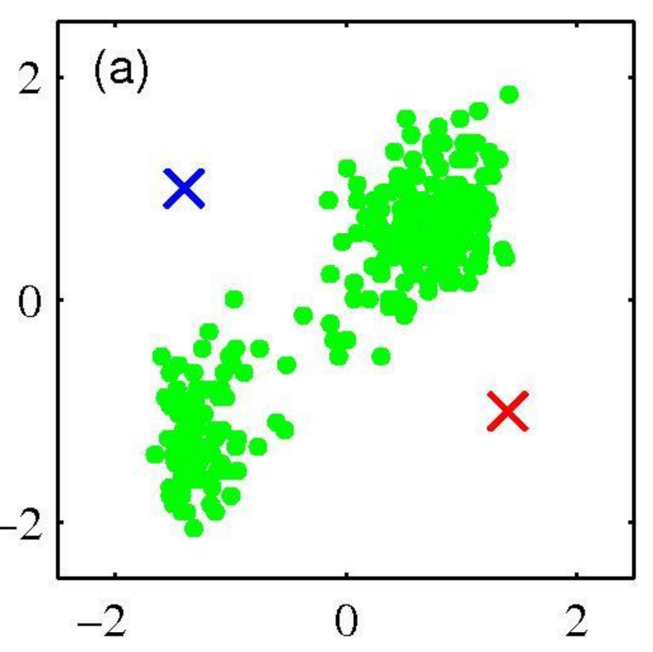
K-means clustering
Pick K random points as cluster centers

Slide 7
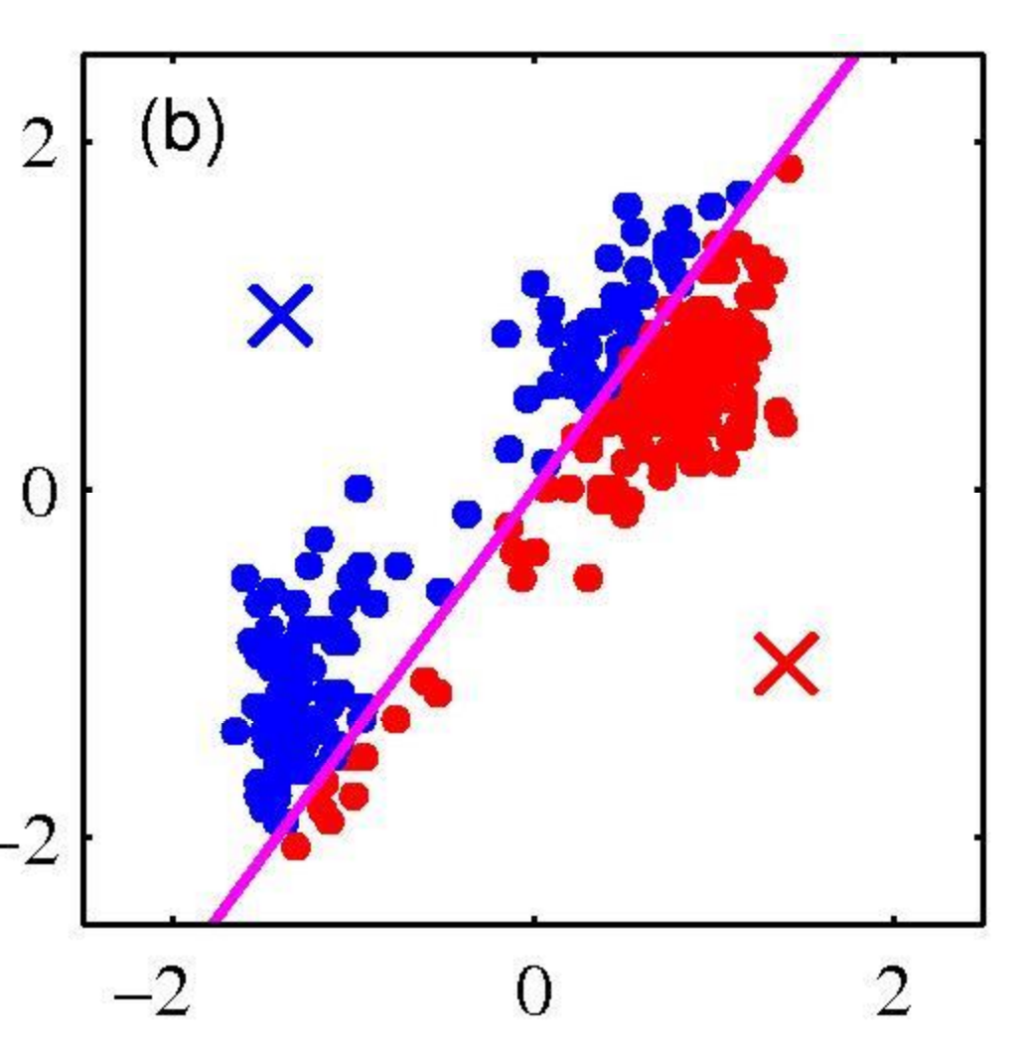
K-means clustering
First Iterative Step 1
Assign data instances to closest cluster center

Slide 8
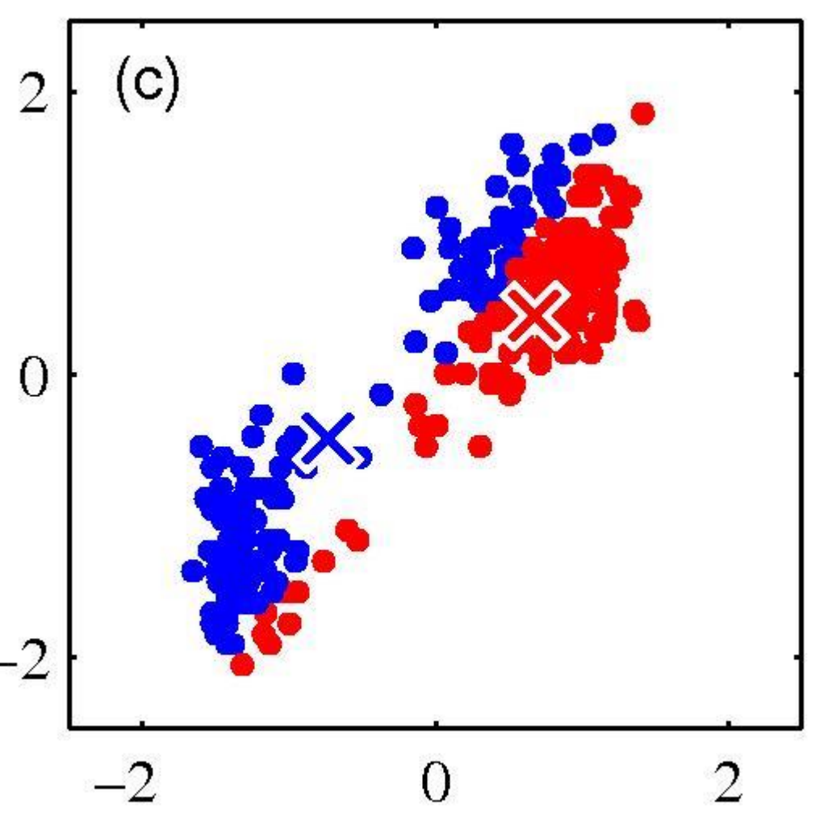
K-means clustering
First Iterative Step 2
Change the cluster center to the average of the assigned points.

Slide 9
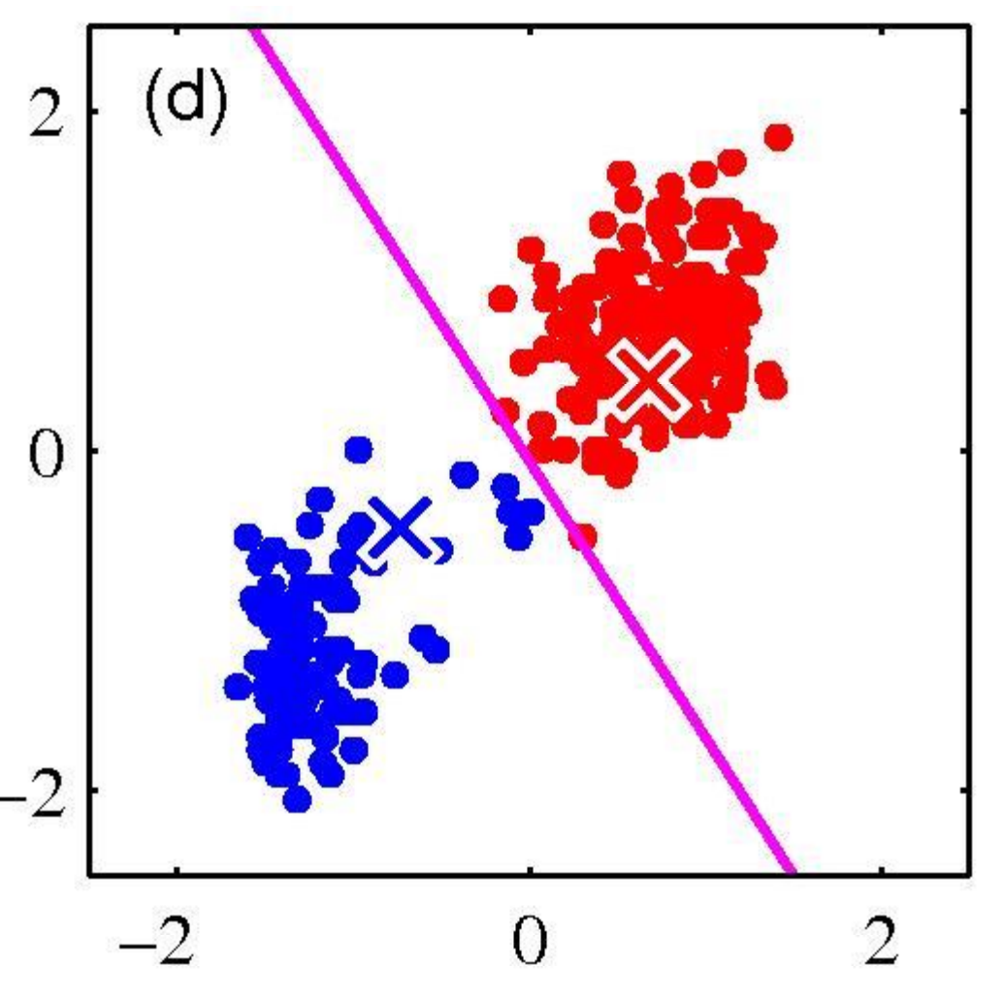
K-means clustering
Second iteration Step 1
Assign data instances to closest cluster center

Slide 10
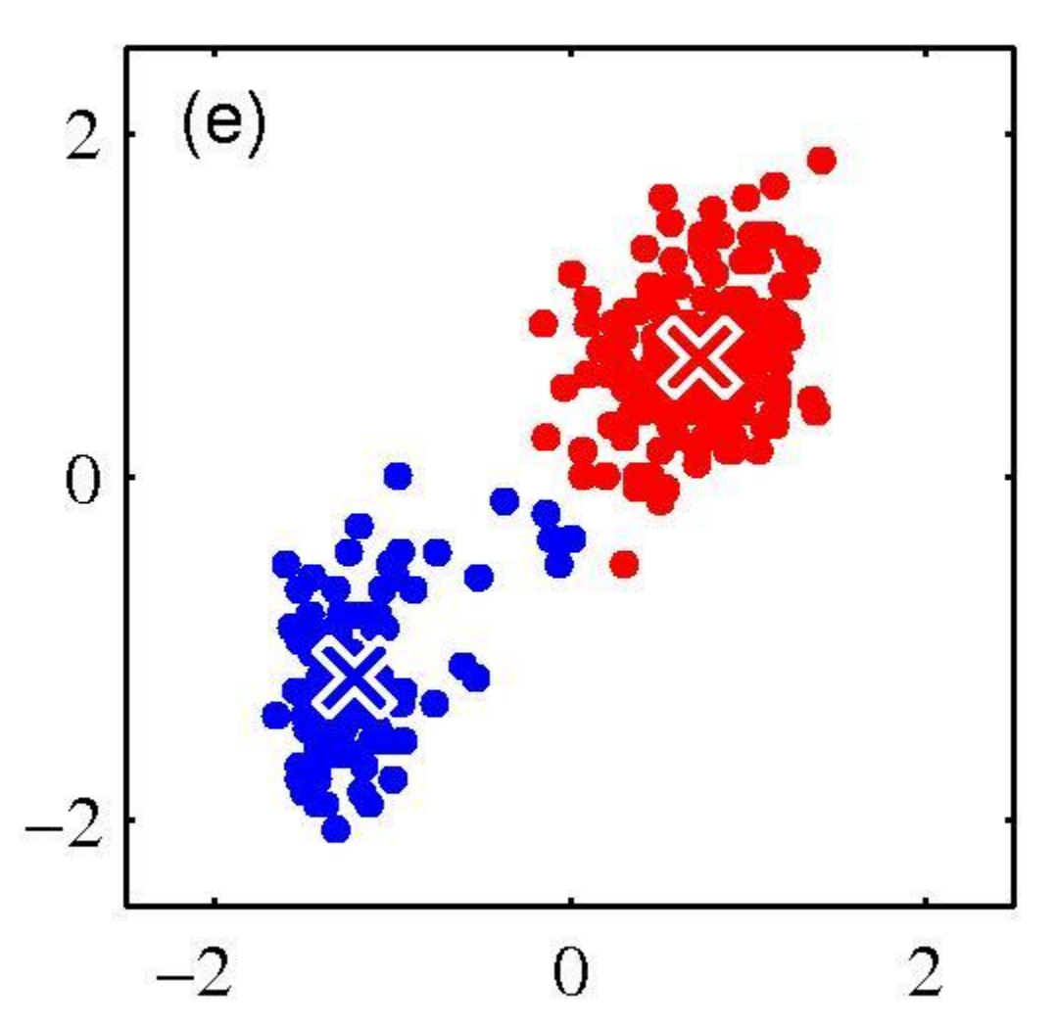
K-means clustering
Second iteration Step 2
Change the cluster center to the average of the assigned points.

Slide 11
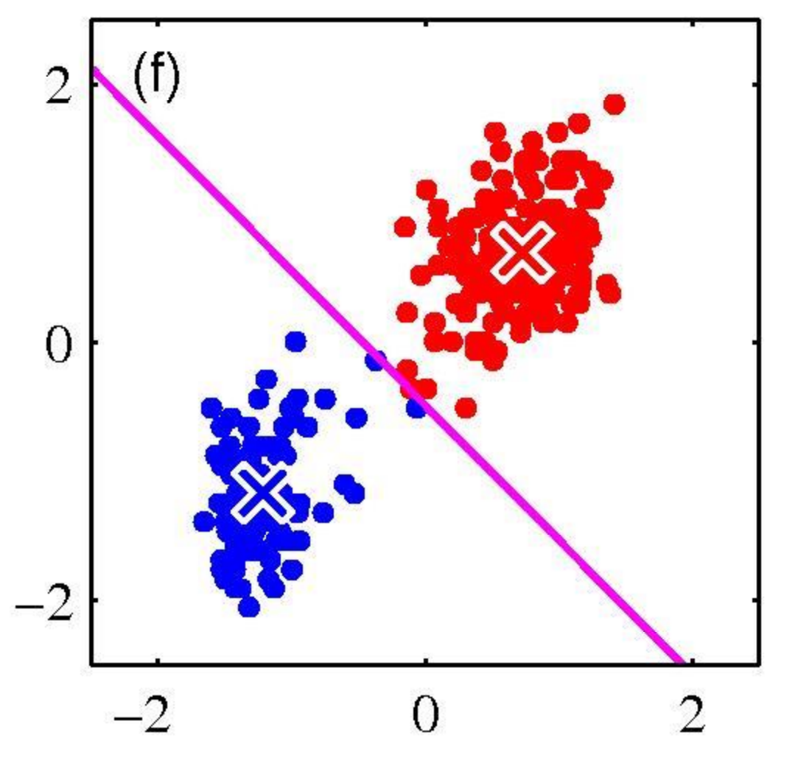
K-means clustering
Third iteration Step 1
Assign data instances to closest cluster center

Slide 12
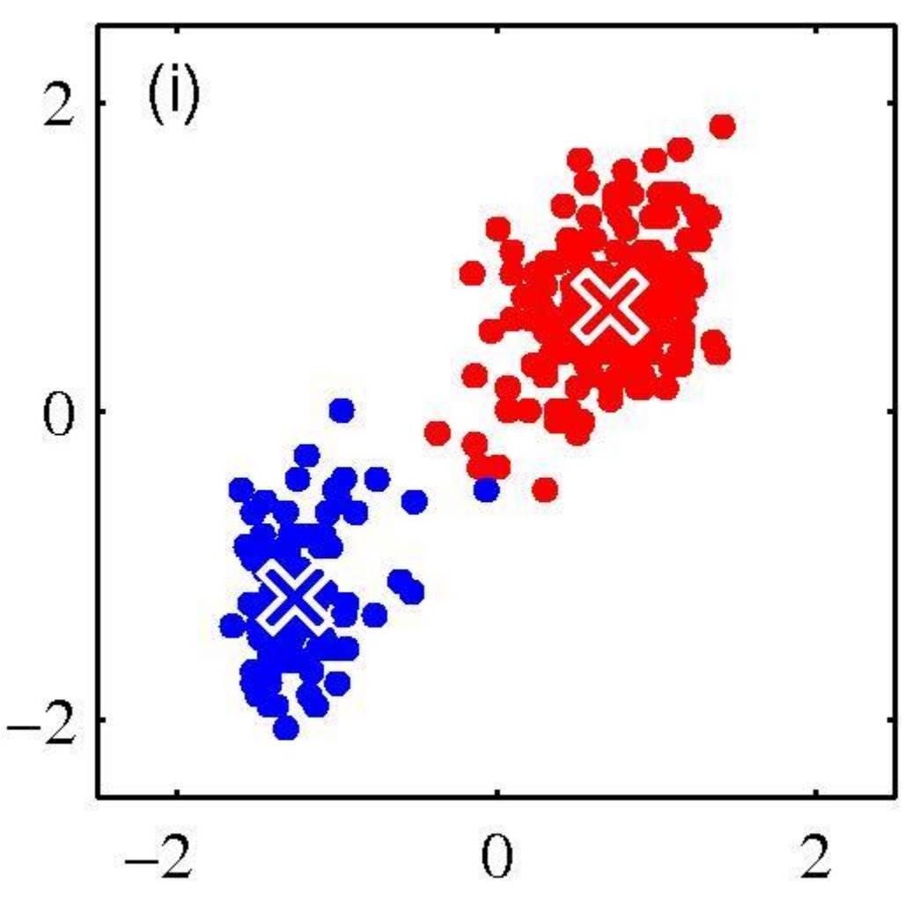
K-means clustering
Third iteration Step 2
Change the cluster center to the average of the assigned points.
Converge!!!

Slide 13
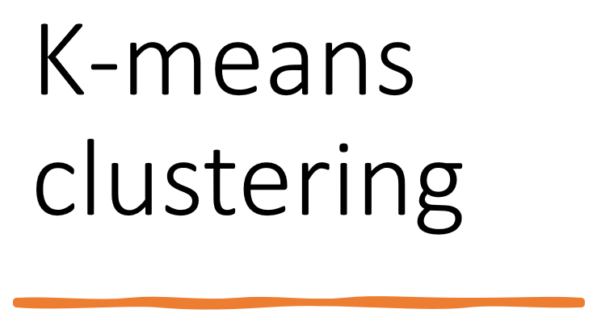

Slide 14
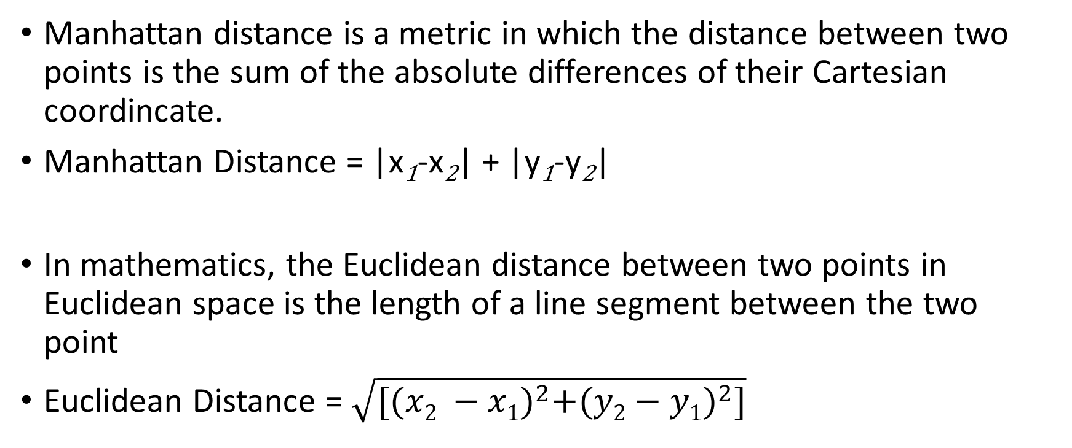
Distance
Manhattan distance is a metric in which the distance between two points is the sum of the absolute differences of their Cartesian coordincate.
Manhattan Distance = |x₁-x₂| + |y₁-y₂|
In mathematics, the Euclidean distance between two points in Euclidean space is the length of a line segment between the two point
Euclidean Distance = $\sqrt{[{(x2 −x1)}^{2}+{(y2−y1)}^{2}]}$

Slide 15
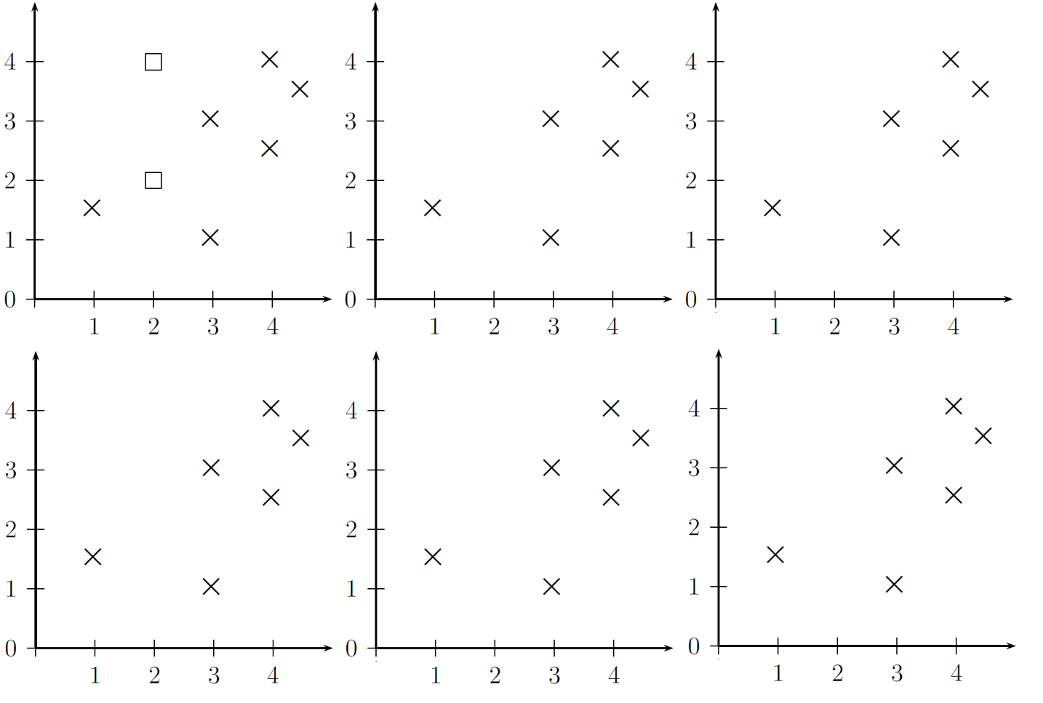
Quiz
Starting with two cluster centers indicated by squares, perform k-means clustering on the six data points (denoted by x). In each panel, indicate the data assignment and in the next panel show the new cluster means. Stop when converged or after 6 steps whichever comes first.

Slide 16
Discussion
Is K-means sensitive to initialization?
Yes!
Example 1:

Slide 17
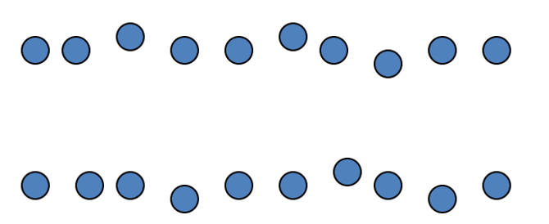
Discussion
Is K-means sensitive to initialization?
Yes!
Example 2

